Slide 1
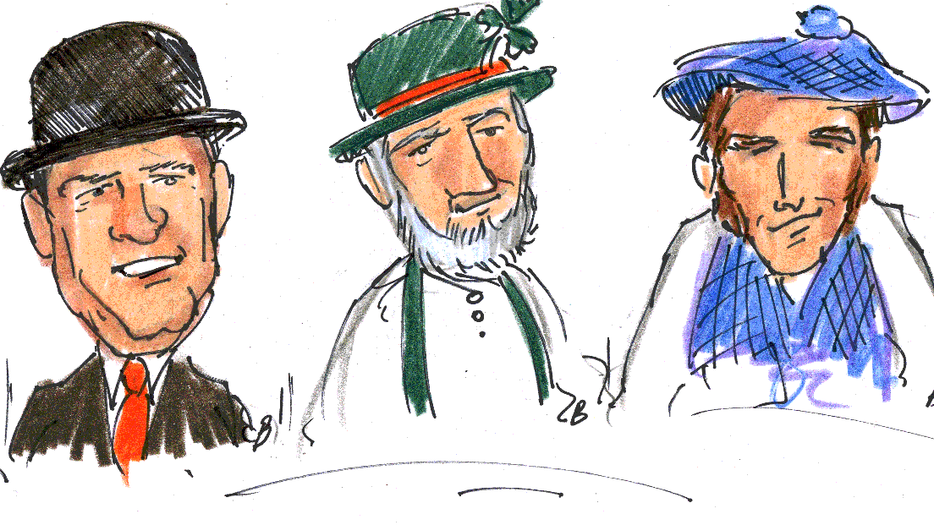
How looks Typical englishman, Scotsman and an irishman
Jak wygląda typowy Anglik, Szkot i Irlandczyk

Slide 2
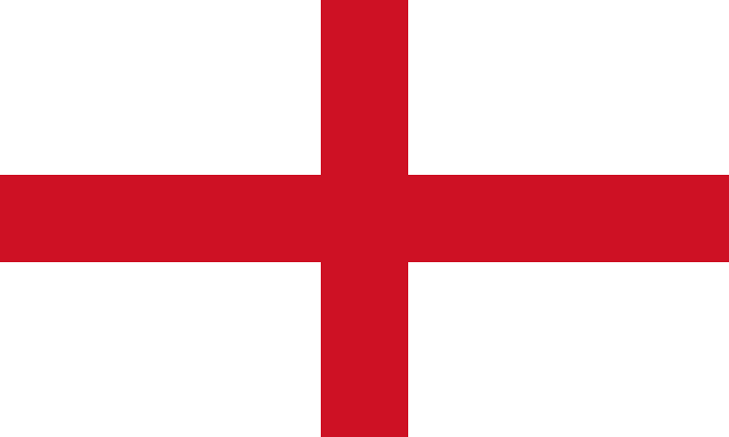

Slide 3
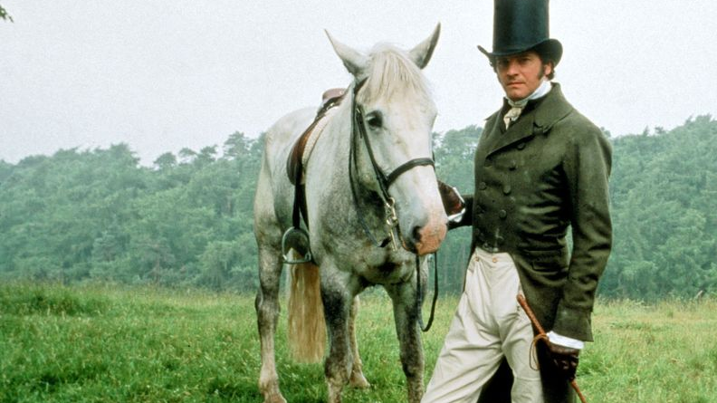
englishman
The classic British menswear look has always been very structured and smart with close-fitting tailoring, collared shirts, and solid chunky shoes.

Slide 4
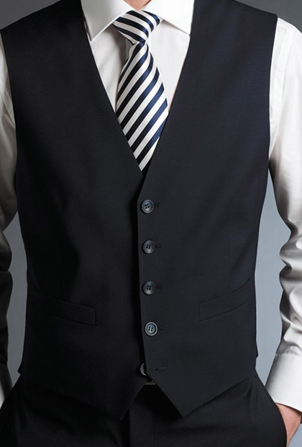
THE WAISTCOAT
Nothing is quite as slimming or as dapper as a well-tailored waistcoat. Again, here, a good fit is crucial. It should be snug at the shoulders without pulling in the back or front.

Slide 5
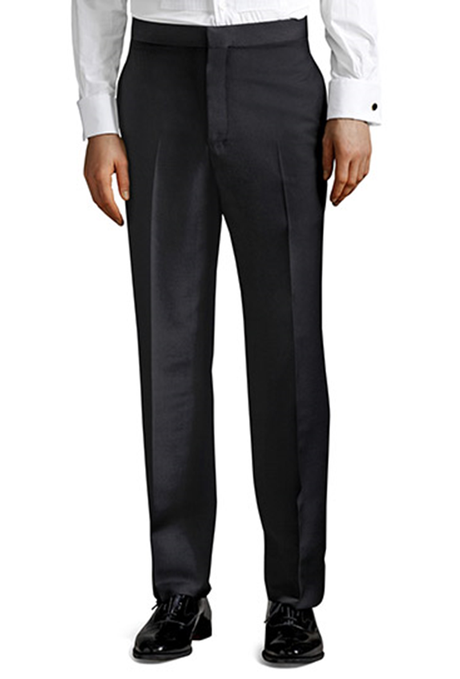
HIGH-WAISTED PANTS
They should be form-fitting around the calves, straight, a bit too loose with crease in them.

Slide 6
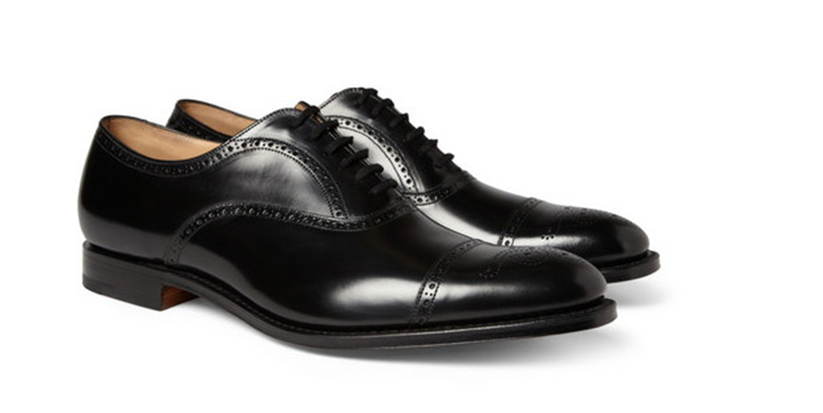
OXFORD BROGUES
Footwear-wise, nothing says English gentleman more than a pair of brogues. The style of low-heeled shoes or boots traditionally characterised by multiple-piece, sturdy leather uppers with decorative perforations (or "broguing") and serration along the pieces' visible edges.

Slide 7
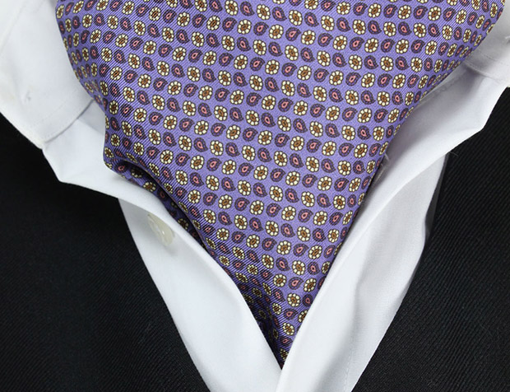
CRAVAT
A cravat is basically a really fat tie, not to be confused with an Ascot tie, which is a narrow neckband with wide pointed wings.

Slide 8
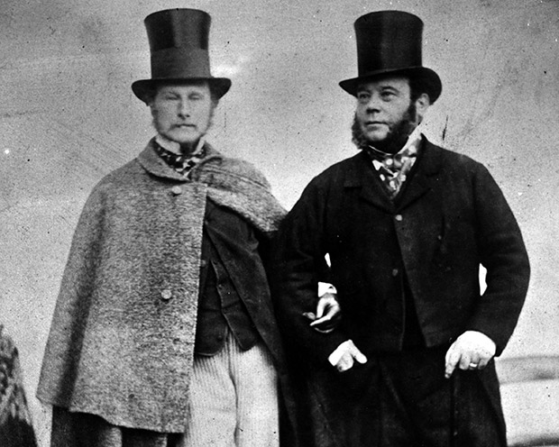
Other accessories
There are plenty of other small items, accessories to complete the appearance. An antique, old gold-watch. A brass Governor Cane. A hook umbrella and a top hat. Just remember to wear any one of these items sparingly and never ever all at once.

Slide 9
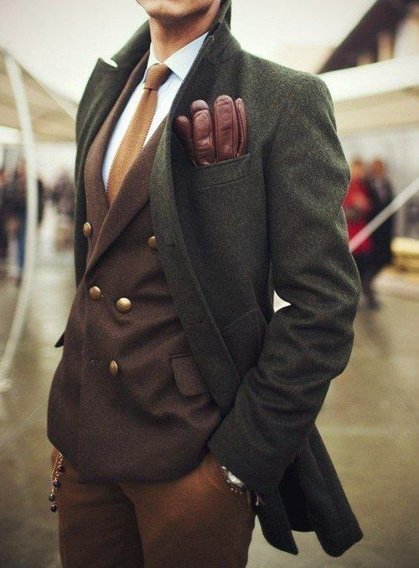
Britishman Gentleman now

Slide 10
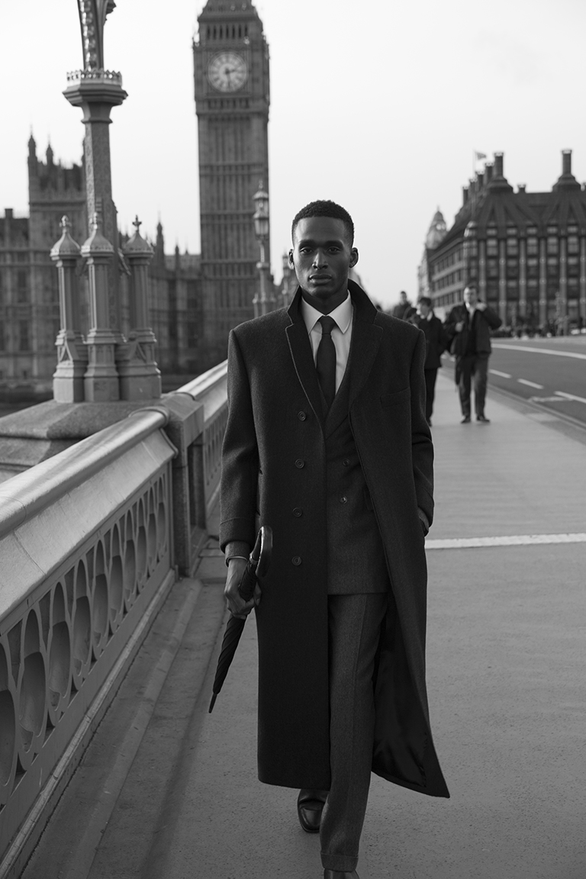
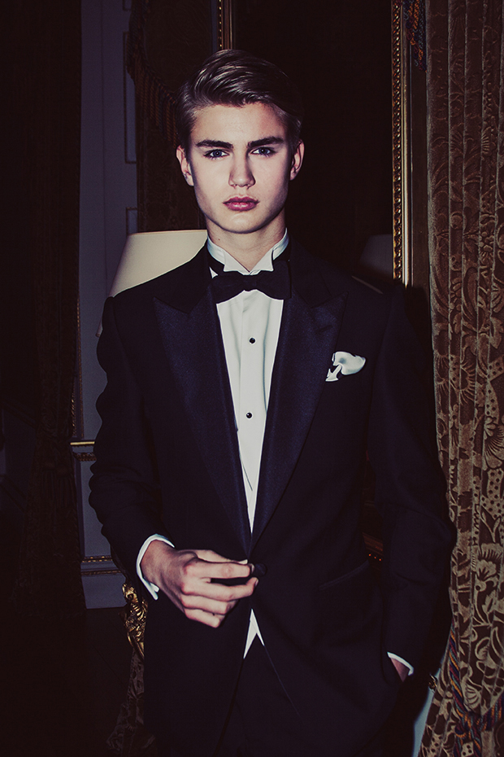

Slide 11
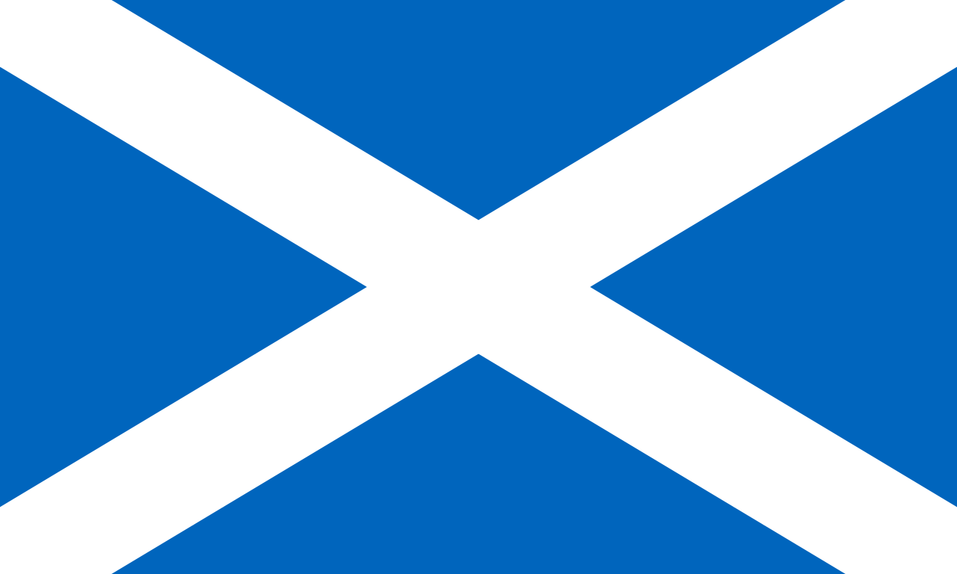

Slide 12
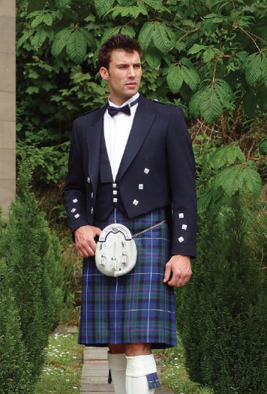
SCOTSMAN
The Scots have a fairly specific type of beauty. Dark, curly hair, dark eyes and staggering, strong and athletic body, light skin, chin placed forward.

Slide 13
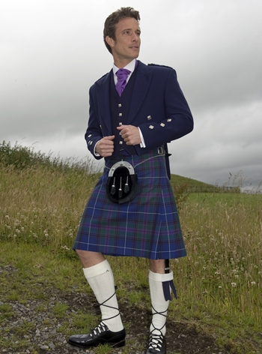
KILT
A kilt is a knee-length non-bifurcated skirt-type garment with pleats at the rear, originating in the traditional dress of men and boys in the Scottish Highlands. The Scottish kilt is usually worn with wooden tight, trousers in winter and wooden socks turn down at the knees in summer.

Slide 14
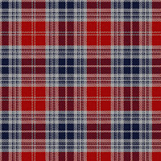
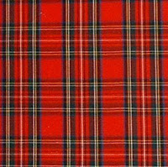
TARTAN
Tartan is a pattern consisting of criss-crossed horizontal and vertical bands in multiple colours. Tartans originated in woven wool, but now they are made in many other materials.

Slide 15
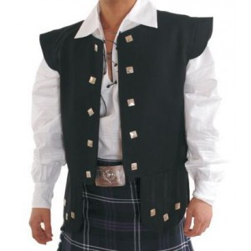
jacobite shirt & chieftain waistcoat
The Jacobite kilt shirt is designed to be loose-fitting and very comfortable. It fastens with a lace threaded through the eyelets,
creating a more casual look to your highland dress outfit.
The chieftain waistcoat is yet one more garment which is worn with a Jacobite shirt,
gives your kilt a very striking casual look.

Slide 16
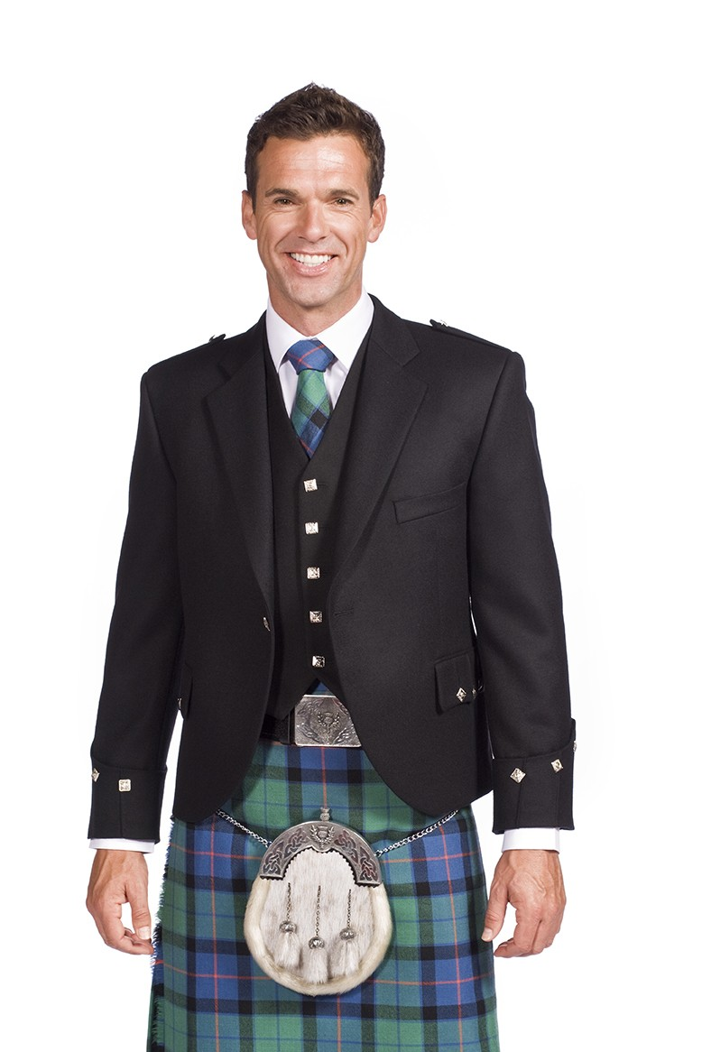
Braemar jacket, ARGYLE JACKET OR CRAIL JACKET
This jacket has single button front kilt Jacket and five button waistcoat in navy.

Slide 17
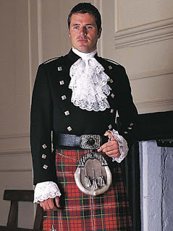
Kenmore, Montrose or Shieffmuir doublet
The Montrose jacket is a double breasted short cut evening Jacket. It can have gauntlet and can be worn with a jabot or tunic shirt.

Slide 18
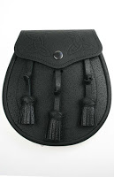
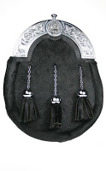
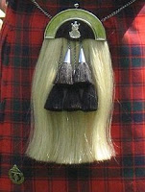
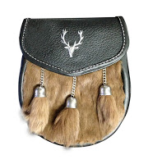
SPORRAN
The sporran, a traditional part of male Scottish Highland dress, is a lether or fur pouch that performs the same function as pockets on the kilt.

Slide 19
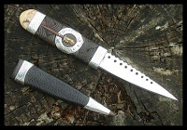
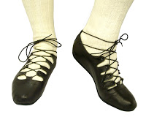
sgian dubh & ghillie brogues
The sgian-dubh is a small, single-edged knife (Gaelic sgian) worn as part of traditional Scottish Highland dress.
The Brogue is a style of low-heeled shoe with decorative perforations. They haven’t got any tongues, but they have got long laces that wrap around the legs above the ankles.

Slide 20
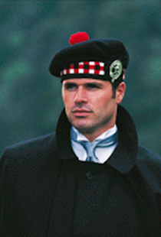
highland bonnet
Highland bonnet is a beret with a tassel and a decorative metal pin.

Slide 21
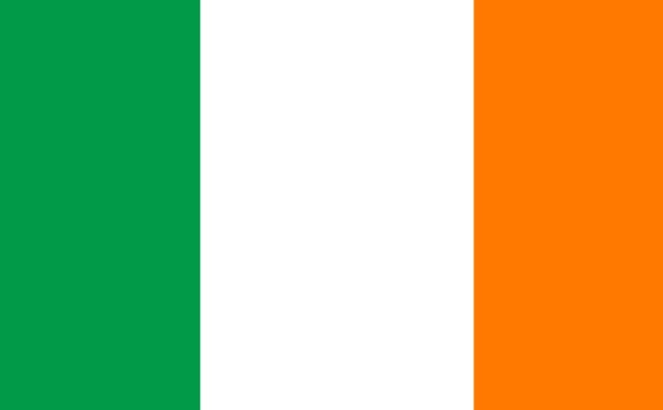

Slide 22
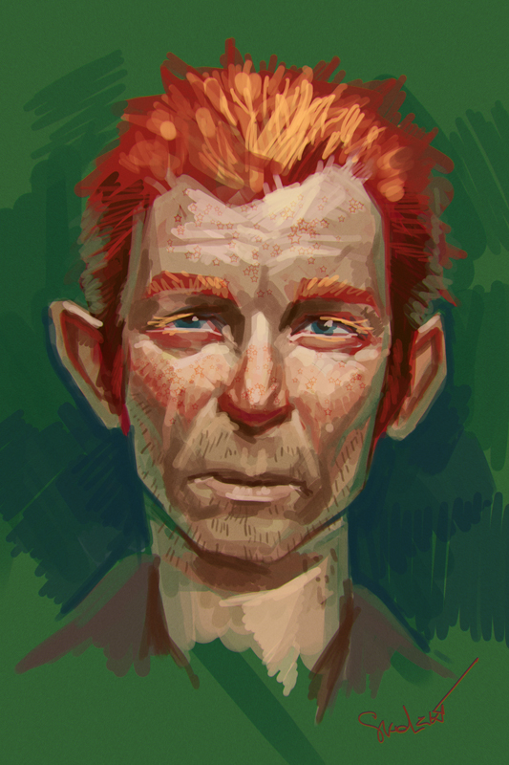
IRISHMAN
There really isn’t a national costume of the Irish.

Slide 23
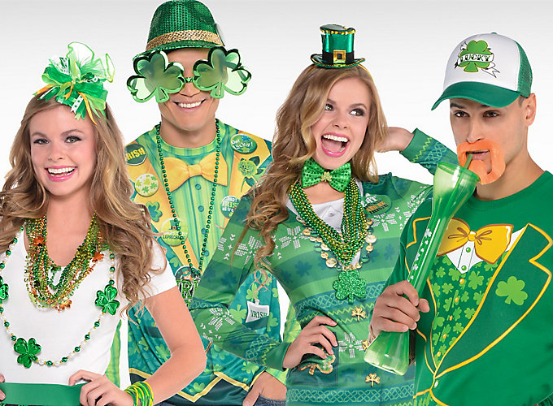
ST Patrick’s day outfit
This day all people wear funny, green costumes

Slide 24
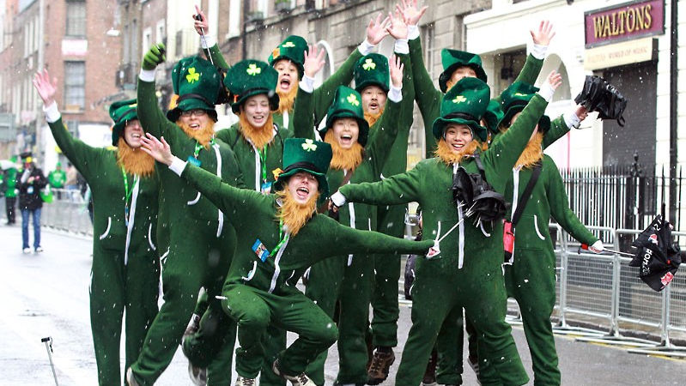

Slide 25
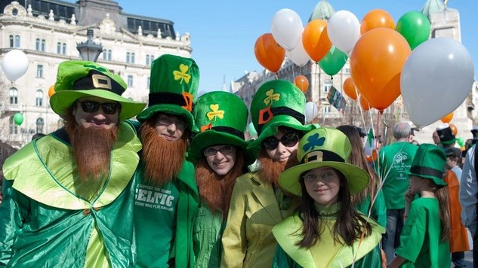

Slide 26
THE END
carer of the project
Mgr Beata Mozdyniewicz
Natalia Bodziarczyk
Martyna Franczyk
Martyna Rozmus
Natalia Szczepaniak

